Slide 1

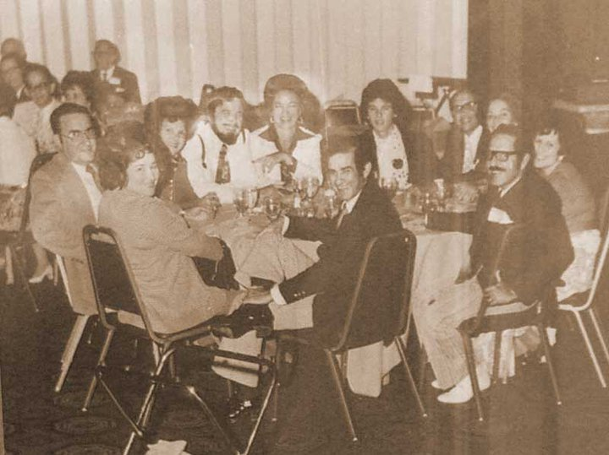
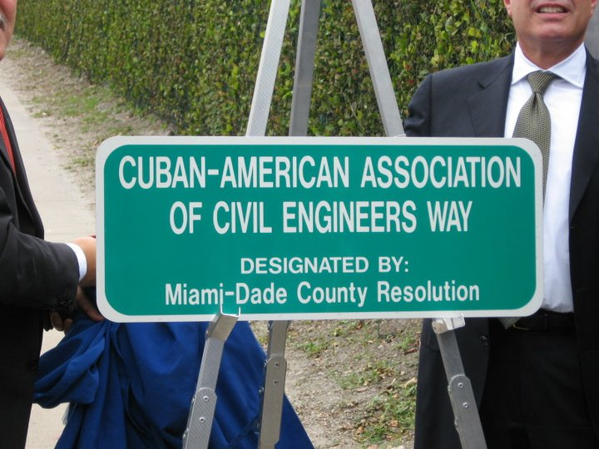
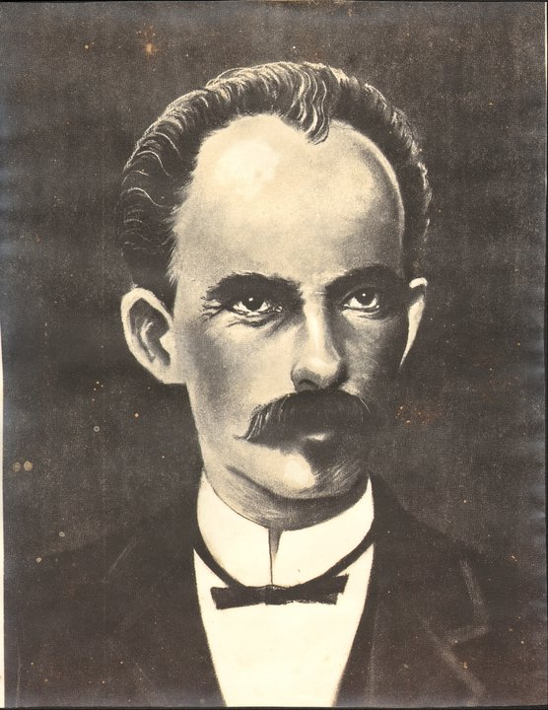
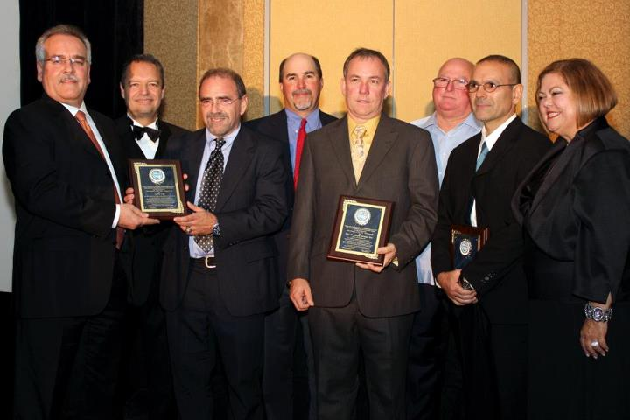
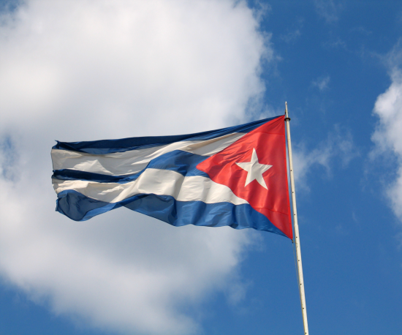
Cuban American Association of Civil Engineers
A Brief History and Future Outlook

Slide 2
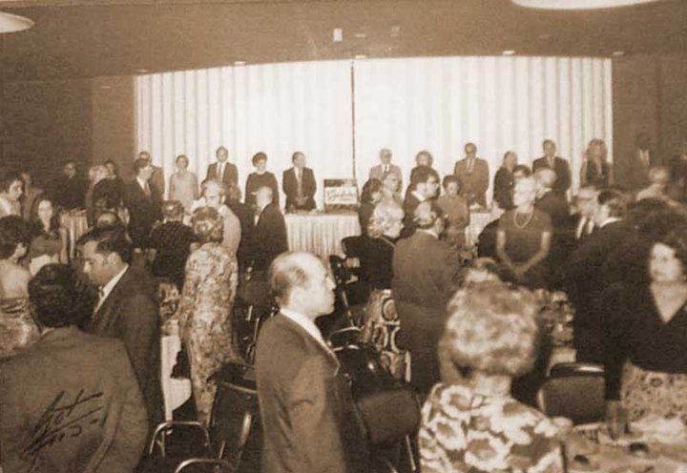
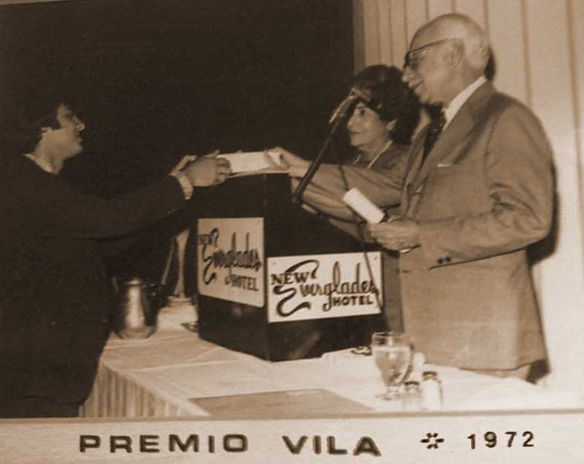
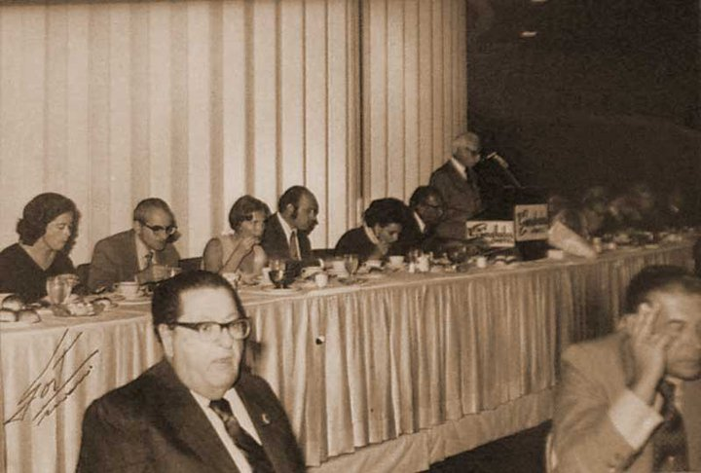
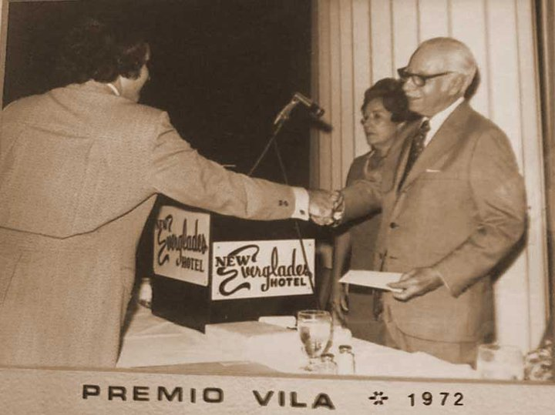
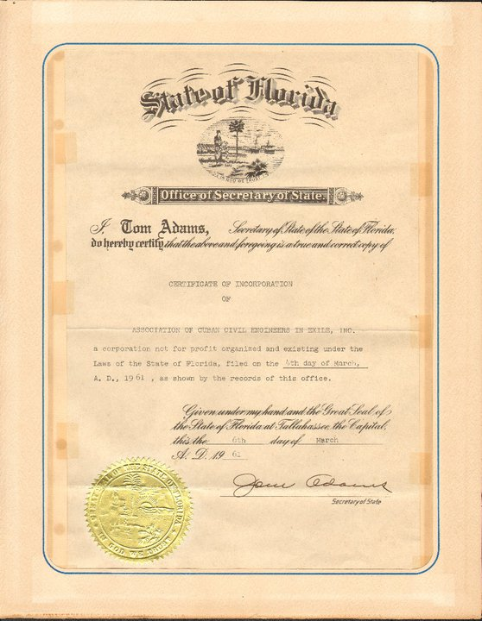
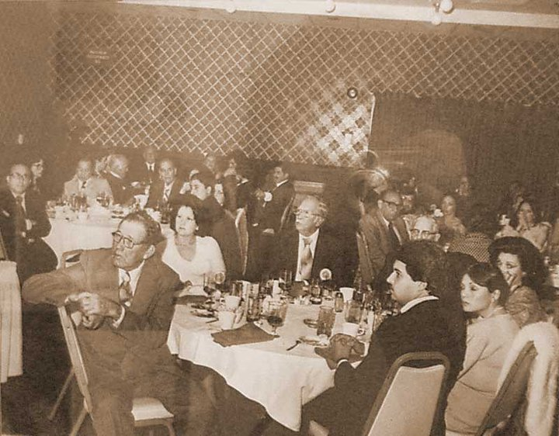
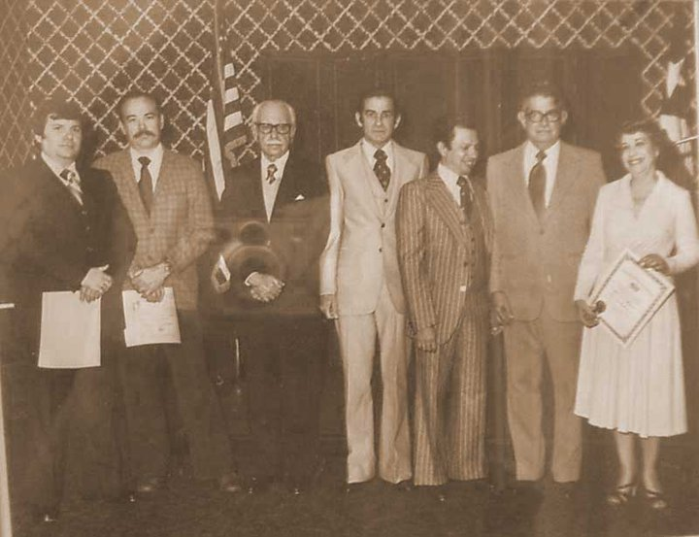
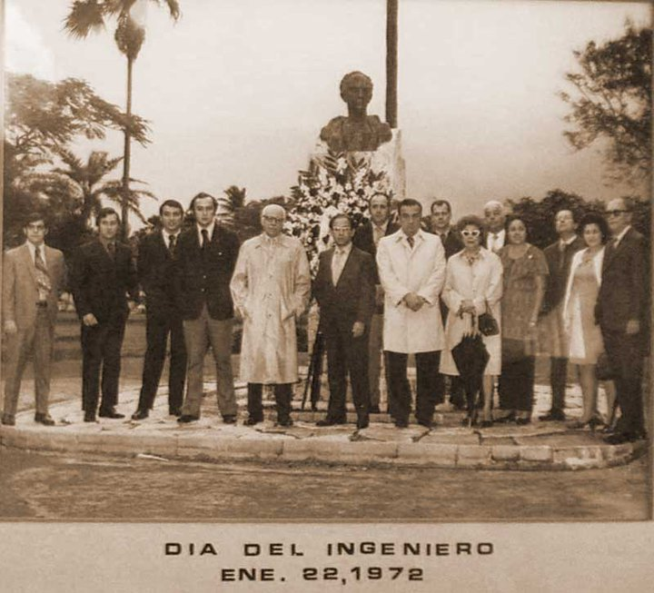
The Early Years
The Cuban American Association of Civil Engineers (CAACE), formerly El Colegio de Ingenieros Civiles de Cuba en Exilio was founded on March 4th 1961
The Organization’s history dates back to Cuba, where El Colegio de Ingenieros Civiles de Cuba was the society and authoritative body for all matters regarding the Civil Engineering Industry on the Island.
The purpose of the Organization was to reestablish el Colegio de Ingenieros Civiles de Cuba in Miami and support the cause of liberty and democracy in Cuba

Slide 3
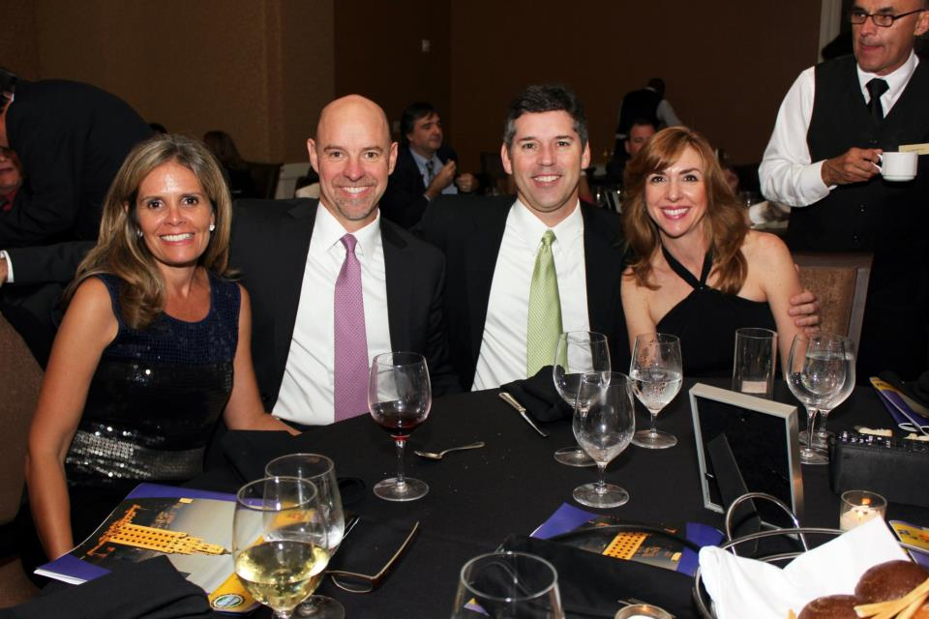
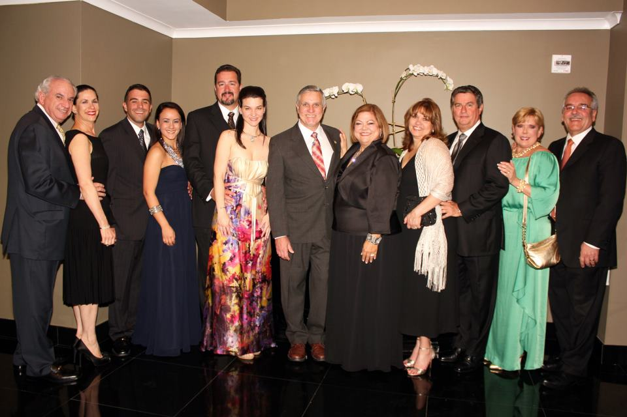
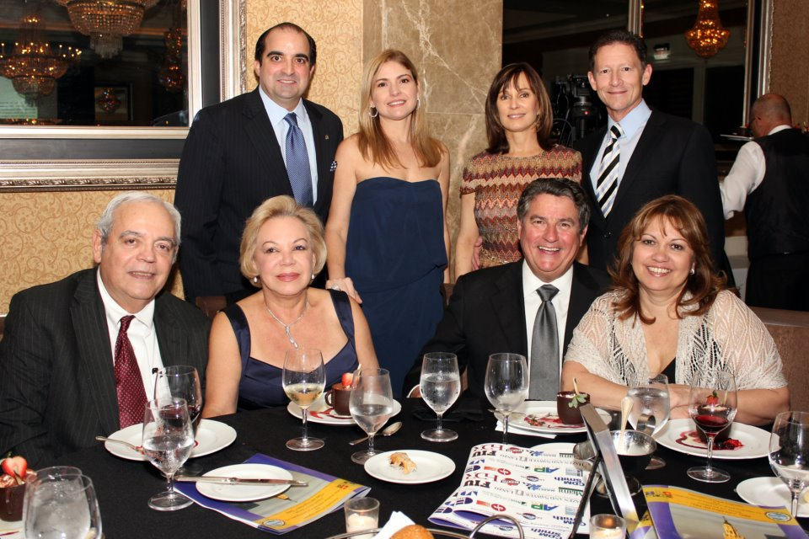
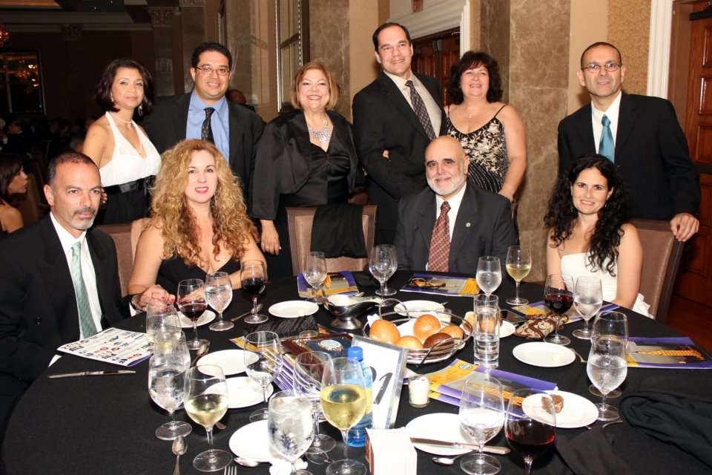
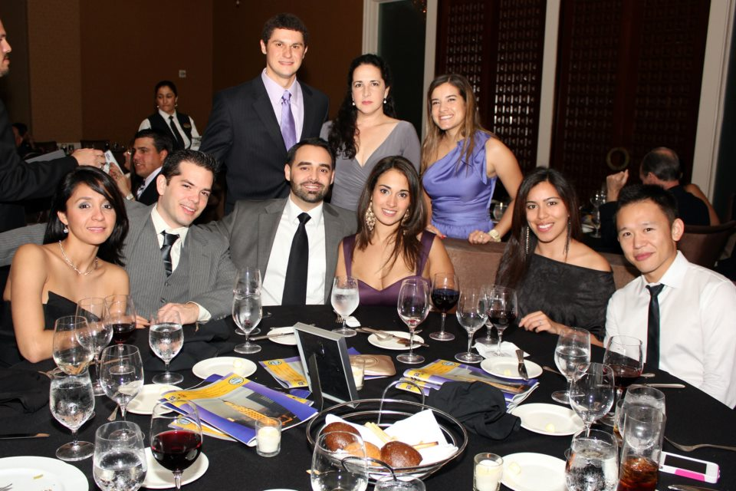
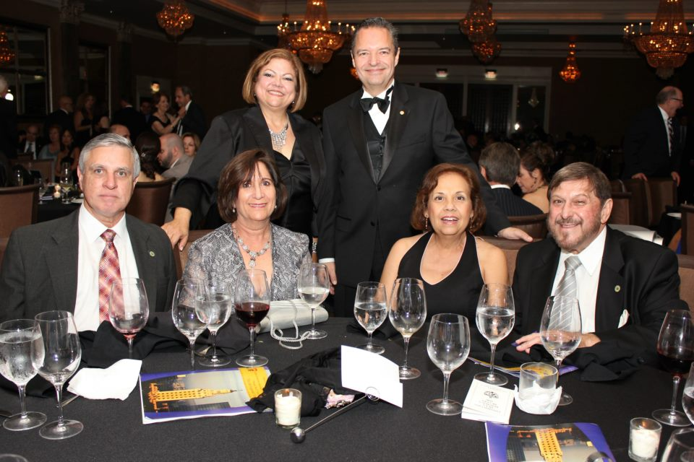
The Early Years Continued
The association grew in membership and activities, exceeding over 500 members by the 1970s.
The Association continued its tradition of hosting the Annual Engineers Gala, a 50 year tradition that continues to this day.
At the Annual Gala, scholarships were awarded in honor of Jose A. Vila, a prominent professor of Civil Engineering at the University of Havana who was a member of CAACE, and a role model. The Scholarships, known as the “Premio Vila”, are name after him.

Slide 4
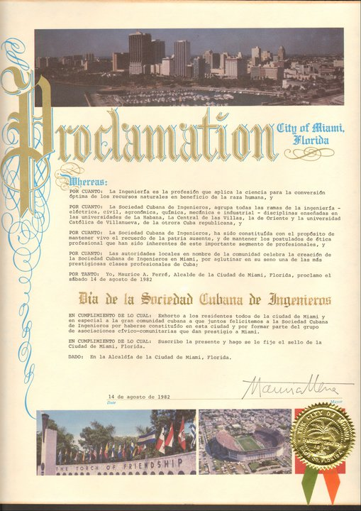
The Early Years Continued
The Association maintained its traditions throughout the 1970’s and 80’s, growing in size and prominence.
Many Engineers, who were members of the organization attained influential positions in the industry. Many of them establishing successful engineering firms, others becoming Directors of Agencies (FDOT, WASD, DERM, etc.), City Managers, County Commissioners, etc.
During this time the Association dedicated itself to helping many engineers arriving from Cuba to revalidate their engineering license (P.E.) through the Florida Board of Professional Engineers, which recognized the Association’s endorsement.

Slide 5

The Modern Era
In 2006 the Articles of Incorporation and Bylaws of the “Association of Cuban Engineers in Exile” were amended.
The name of the Organization was changed to the “Cuban American Association of Civil Engineers” and the Mission Statement redrafted to better reflect the Association’s objectives.

Slide 6
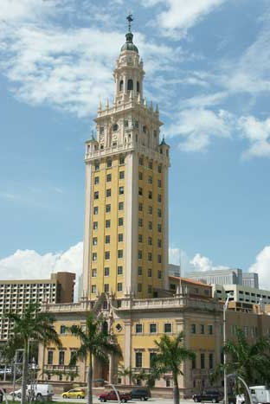
Mission Statement
Today CAACE’s Mission Statement is:
  To assist members in the maintenance of the highest professional engineering skills and to aid the members in retaining and exercising said skills.
  To maintain and support the highest principles of professional engineering achievements.
  To obtain the advancement of the science and profession of engineering.

Slide 7
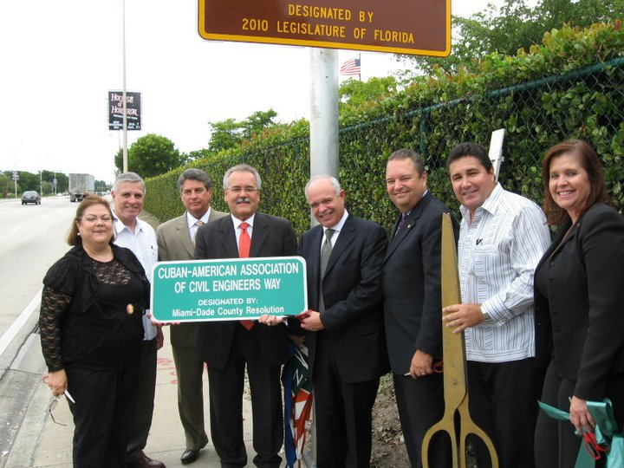
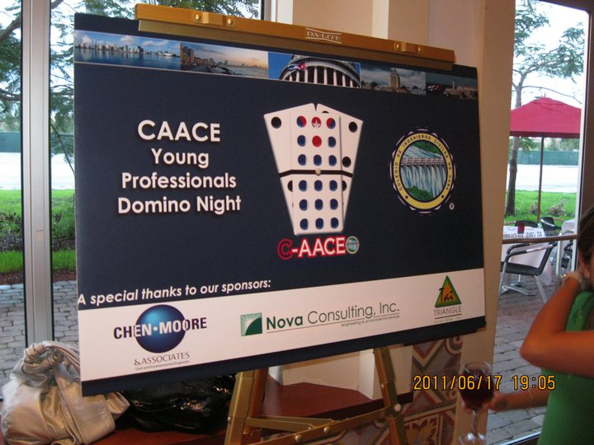
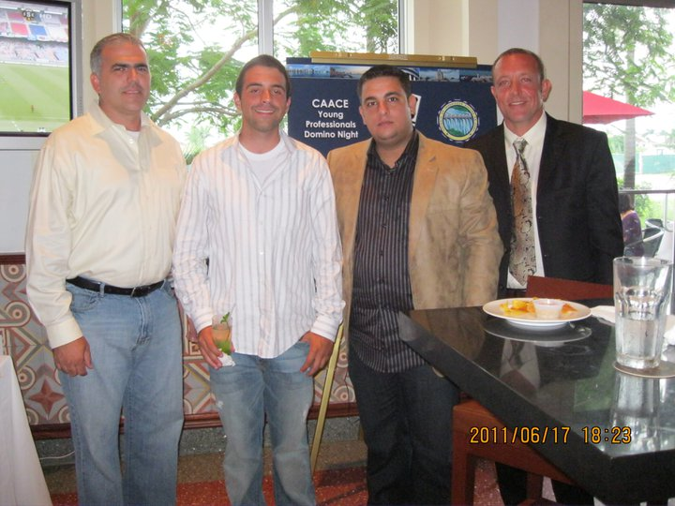
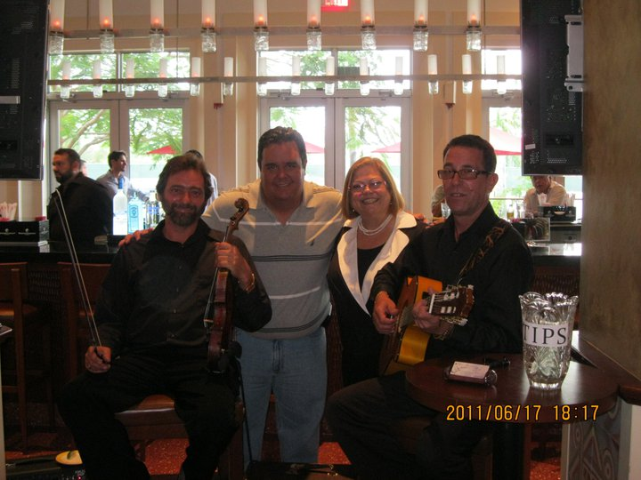
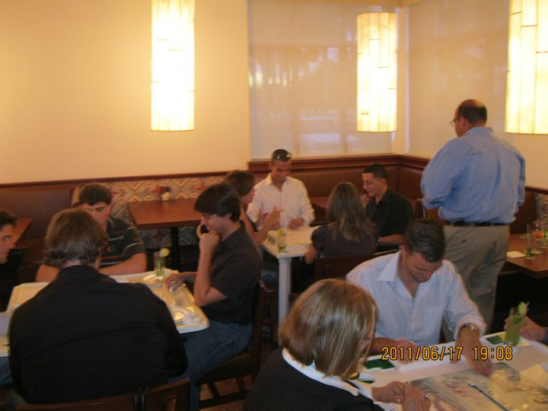
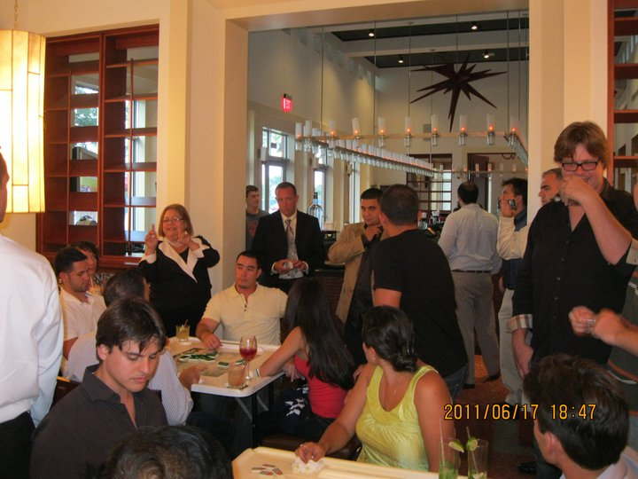
CAACE Activities
CAACE Hosts a significant number of Activities including:
  Monthly Meetings
  Community Service Events
  Cuba Infrastructure Challenge
  Annual Engineer’s Gala
  Younger Member Events*

Slide 8
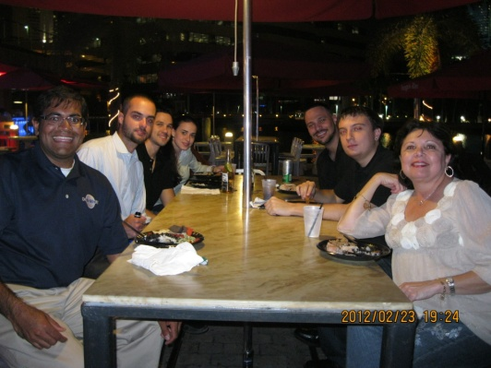
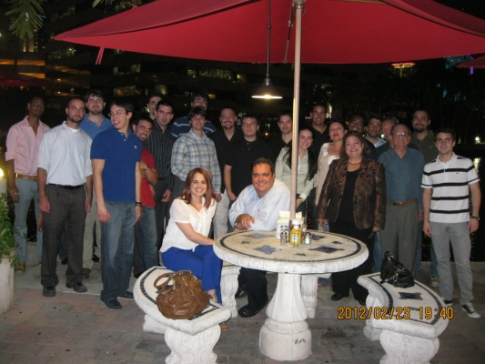
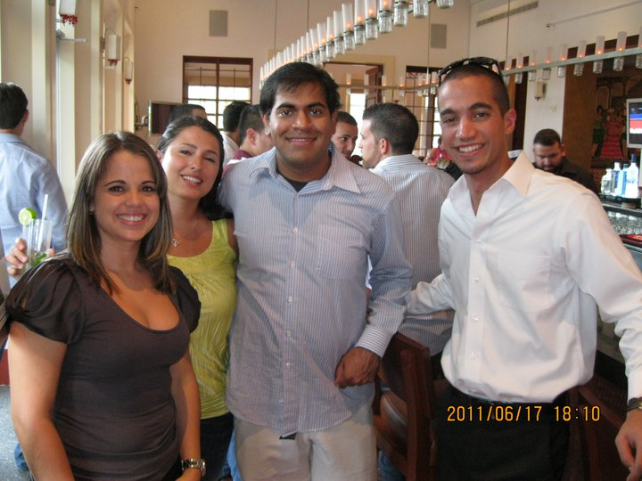
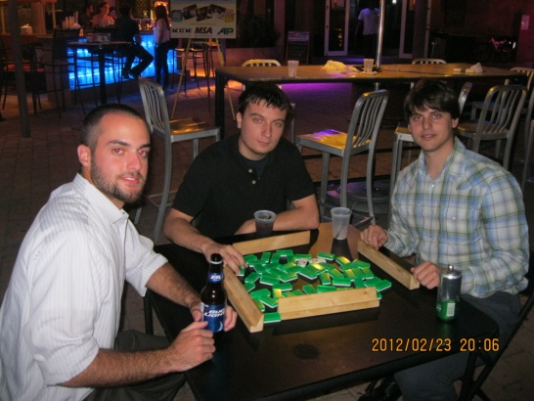
Young Professionals/Student Group
The CAACE Young Professionals host their own events to encourage membership participation and opportunities for younger members
Events Include:
  Socials (Domino Nights, Guateques, etc.)
  Networking Events
  Community Service
  and Many More

Slide 9

Our Next Initiative – FIU Student Chapter
The Cuban American Association of Civil Engineers would like to establish a Student Chapter at Florida International University
CAACE is looking for students who are interested in becoming part of our Association and leading the Founding of the first Student Chapter
This is a unique opportunity and a chance to kick-start you career in Civil Engineering while giving back to the communityy and partaking in you Cuban Heritage.

Slide 10
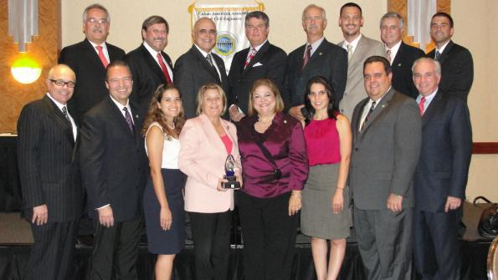
Thank you for your Time!
Questions?

