Slide 1
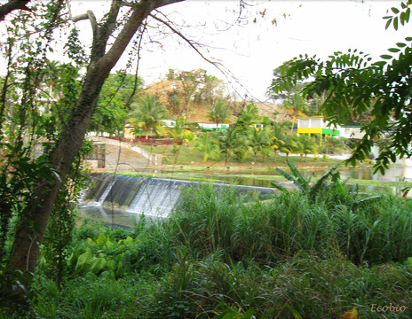
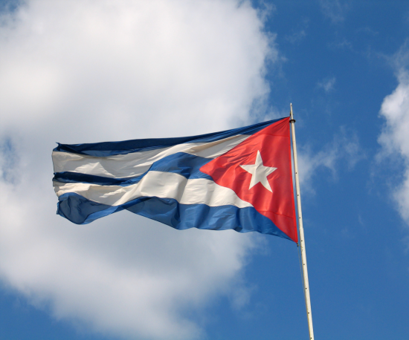
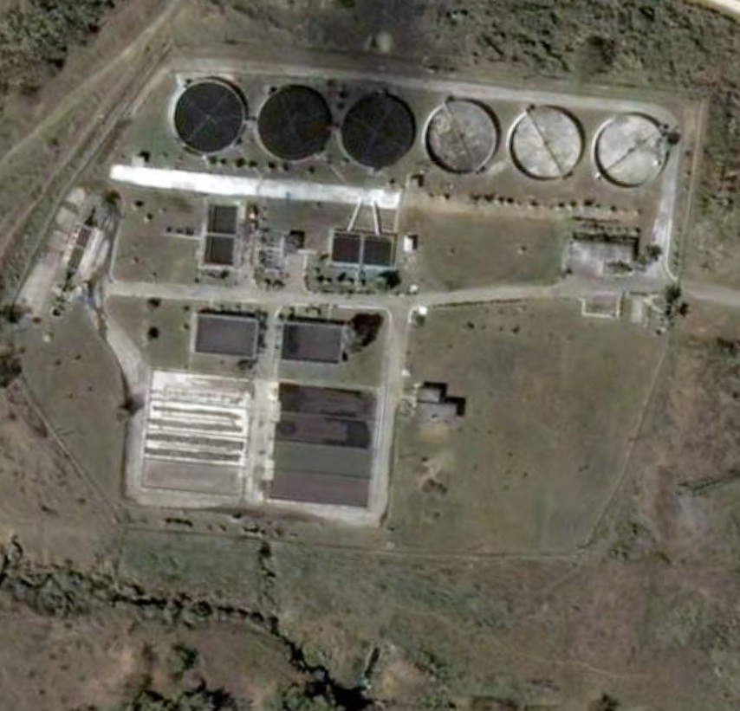
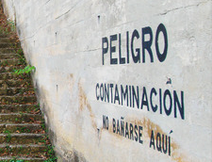
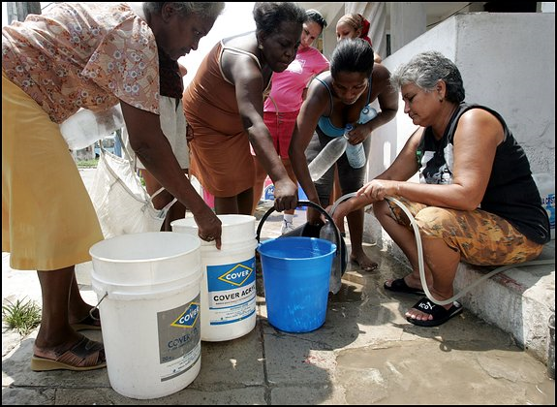
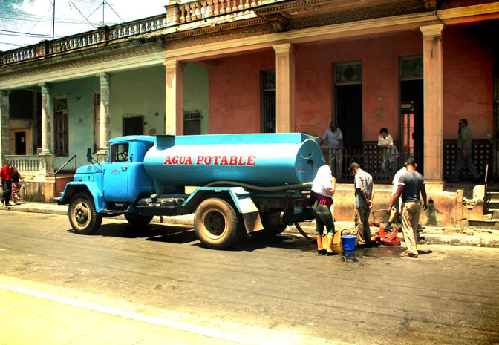
An Evaluation of Cuba’s water and wastewater infrastructure
Feb 12, 2014
FIU Cuban Research Institute
Josenrique Cueto

Slide 2
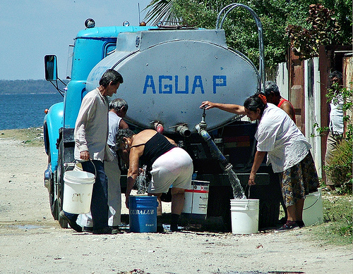
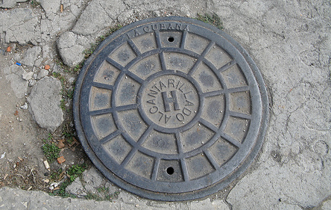
OVERVIEW
Water
  Sources
  Current Infrastructure
  Demand vs. Capacity
  Improvements & Costs
Wastewater
  Overview
  Current Infrastructure
  Demand vs. Capacity
  Improvements & Costs
Conclusions

Slide 3
WATER SOURCES
Surface Water
  Accounts for 65% of Cuba’s Available Water Supply
  8 Priority Watersheds
    Serve 40% of Population
    Cuyaguateje, Ariguanabo, Almendares-Vento, Hanabanilla, Zaza, Cauto, Guantanamo-Guasa and Toa
Ground Water
  35% of Cuba’s Available Water Supply
  Specific Regions where Ground Water Predominates:
    La Habana, Matanzas, Ciego de Avila, and Camaguey

Slide 4
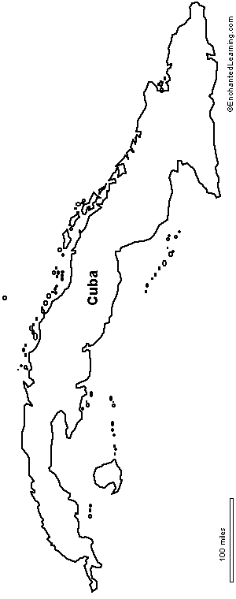

PRIORITY WATERSHEDS
Ariguanabo y Almendares - Vento
Havana
Matanzas
Zaza
Villa Clara
Ciego De Avila
Pinar
Del Rio
Cienfuegos
Las Tunas
Sancti Spiritus
Holguin
Cuyaguateje
Isla de la Juventud
Hanabanilla
Rio Toa
Rio Toa
Camaguey
Granma
Guantanamo
Santiago De Cuba
Cauto
Guantanamo Guasa
Source : (Perez et al. 2009)

Slide 5
WATER TREATMENT INFRASTRUCTURE
Surface Water
  59 Surface Water Treatment Plants
      Shortage of Chemicals and Chemical Dosing Equipment
      Poor Equipment Reliability (pumps, instrumentation, etc.)
      Quantity and Quality of Filter Media
Ground Water
  2,000 Ground Water Chlorination Stations
    Primary Disinfectant: Chlorine Gas
    Current Challenges
      Shortage of Chlorine
Notes:
Q

Slide 6
WATER TREATMENT PLANT ATLAS
Camaguey
Isla De La Juventud
Guantanamo
Surface Water Treatment Plants
Small WTP 0-99 L/S
Granma
Medium WTP 100-499 L/S
Santiago De Cuba
Large WTP 500+ L/S

Slide 7
CHLORINATION STATION DENSITY
Camaguey
Isla De La Juventud
Guantanamo
0
Surface Water Treatment Plants
Granma
Santiago De Cuba
Chlorination Station Density
Small WTP 0-99 L/S
Medium WTP 100-499 L/S
Large WTP 500+ L/S
300

Slide 8
WATER TREATMENT
DEMAND & CAPACITY
Demand
  Population: 11.25 Million
  Overall Demand: 1.77 m³/person/day
    Demand Breakdown:
      12% Industrial
      19% Domestic: 0.34 m³/day/capita
      69% Agricultural
Capacity
  Overall Treatment Capacity: 0.36 m³/person/day
    Capacity Breakdown by Source:
      Surface Water: (28%)
      Ground Water: (72%)
Notes:
Q

Slide 9
WATER DISTRIBUTION
Overview of System
  19,000 km of Pipe Network
  2,375 Pump Stations
Current Challenges
  Deteriorated Piping
  Unreliable Pump Stations
Result:
  Available Potable Water is Not Equal to Potable Water Demand
Notes:
Q

Slide 10
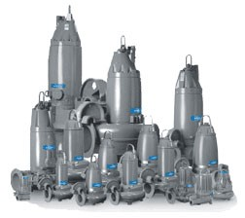
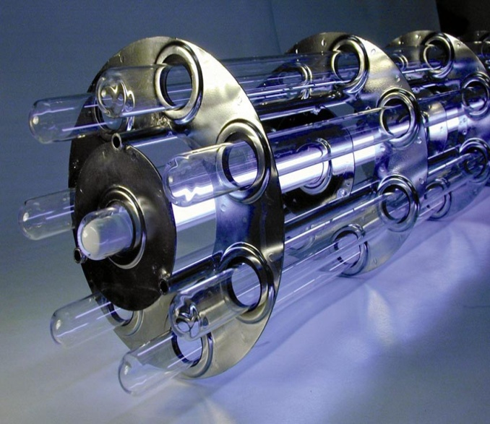
HIGH PRIORITY IMPROVEMENTS
Water Distribution System
  Repair Piping
Pump Stations
  Rehabilitate & Upgrade Pump Stations
    Ensure conveyance of potable water throughout system
Disinfection
  Increase Chlorine Production
    Disinfection of the water supply.
Notes:
Q

Slide 11
COST ESTIMATE FOR DRINKING WATER SERVICE (CONTINUED)
Overall Cost of Water System Improvements
Upgrade of Existing Potable Water Pump Stations (Million USD) | $1,100
Repair of Distribution System (Million USD) | $2,400
Sodium Hypochlorite Generation (Million USD) | $20
Total | $3,520
Notes:
Q

Slide 12
WASTEWATER TREATMENT
OVERVIEW
Sanitary Coverage estimated at 94% (PAHO 2000)
  38% Connections to Wastewater Collection Systems
  56% In-Situ Wastewater Systems
  6% Without Service
In 2007, estimated 4% of wastewater collected was treated (Belt and Velazquez, 2007)
Stabilization Lagoons used predominantly for industrial wastewater.

Slide 13
WASTEWATER TREATMENT PLANTS
EXISTING PLANTS
11 Existing Wastewater Treatment Plants
  Within the City of La Habana
    3 WWTPs
  Outside of the City of La Habana
    8 Plants mostly in Tourist Areas
      Varadero, Villa Clara, Cayo Coco
Only 3 are suspected to be currently operational
  Maria del Carmen
  Quibu
  Solar Aquatic System

Slide 14
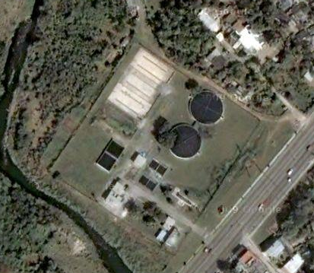
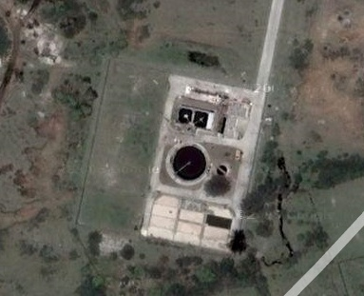
WASTEWATER TREATMENT PLANTS
NEW PLANTS
6 Future Wastewater Treatment Plants
  Within the City of Havana
    2 Plants on Almendares River Basin
    4 Plants by Habana Bay (Luyano & Martin Perez Rivers)
3 have begun construction but are delayed
  El Pitirre (Cotorro)
  Lower Luyano
  Upper Luyano
3 are in the planning stage

Slide 15
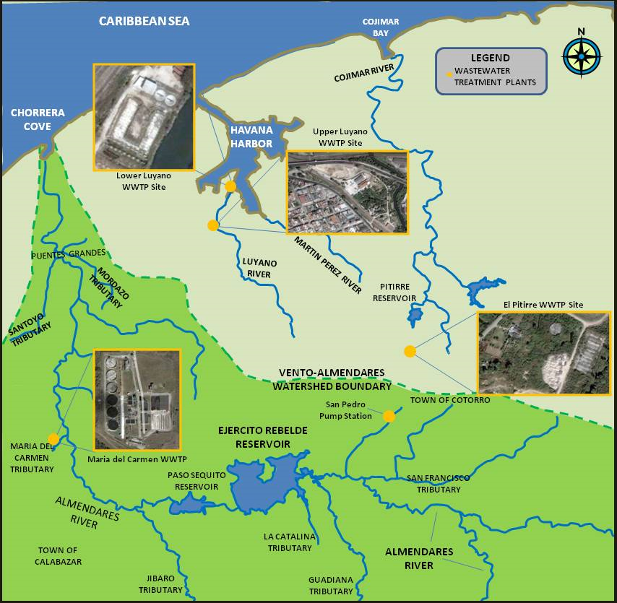
WASTEWATER TREATMENT PLANTS
WITHIN CITY OF LA HABANA

Slide 16
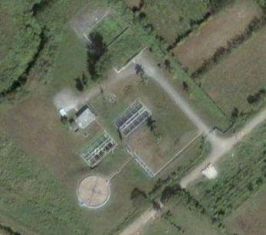
WASTEWATER TREATMENT PLANTS
OUTSIDE CITY OF LA HABANA
CUBA WASTEWATER TREATMENT PLANTS
WWTP
Camaguey
Isla De La Juventud
Holguin
Guantanamo
Las Tunas
Granma
Santiago De Cuba
Quibu WWTP
Bejucal WWTP
Holguin WWTP

Slide 17
WASTEWATER TREATMENT
DEMAND & CAPACITY
Demand
  Population: 11.25 Million
  Overall Demand: 3.02 mil m³/d, or 0.27 m³/person/day
  Demand Breakdown:
    Urban 76% (2.30 mil m³/day)
    Rural 24% (0.72 mil m³/day)
Capacity
  Only 2 large plants are operational and at 1/3 capacity:
    21,600 m³/day (<1% of existing wastewater flows)
  If all existing treatment plants were operational:
    107,900 m³/day
  After completion of two plants on Luyano:
    246,140 m³/day
  If all delayed and plants in planning were completed:
    ~400,000 m³/day (<15% of existing wastewater flows)
Notes:
Q

Slide 18
WASTEWATER TREATMENT
HIGH PRIORITY IMPROVEMENTS
Rehabilitation of existing wastewater infrastructure:
  Collection System (Sewers)
  Pump Stations
  Wastewater Treatment Plants
Priority should be given to protection of source water quality to ensure public health
Emphasis on highly populated areas (cities with population > 100,000)

Slide 19
WASTEWATER COST ESTIMATES
OVERALL
Overall Cost of Wastewater Infrastructure Improvements
Wastewater Collection System Improvements (Million USD) | $1200
Wastewater Treatment Plant Improvements (Million USD) | $550
Wastewater Pump Station Improvements (Million USD) | $450
Total (Million USD) | $2,200
Notes:
Q

Slide 20
OVERALL COST OF IMPROVEMENTS
Water Infrastructure Improvements (Billion USD) | $3.52
Wastewater Infrastructure Improvements (Billion USD) | $2.20
TOTAL (Billion USD) | $5.72
Notes:
Q

Slide 21
CONCLUSION
Current condition of Cuba’s water and wastewater system warrants extensive improvements to both systems.
Final Recommendations:
  Improvement of Water Distribution System
  Nationwide On-Site Sodium Hypochlorite Generation
  Rehabilitation of Existing Wastewater Infrastructure
  Construction of Priority New Wastewater Infrastructure to meet demand/protect human health.

Slide 22
An Evaluation of Cuba’s water and wastewater infrastructure
Feb 12, 2014
FIU Cuban Research Institute
Josenrique Cueto

